Slide 1
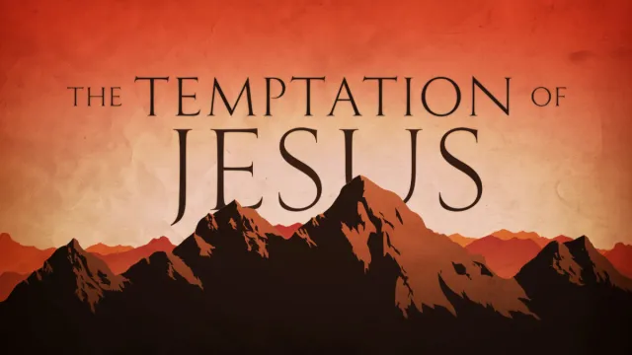

Slide 2


Slide 3


Slide 4
⁴ Hear, O Israel: The Lord our God, the Lord is one. ⁵ Love the Lord your God with all your heart and with all your soul and with all your strength.
Deuteronomy 6:4-5

Slide 5


Slide 6
Remember how the Lord your God led you all the way in the wilderness these forty years, to humble and test you in order to know what was in your heart, whether or not you would keep his commands. Deuteronomy 8:2

Slide 7
He humbled you, causing you to hunger and then feeding you with manna, which neither you nor your ancestors had known, to teach you that man does not live on bread alone but on every word that comes from the mouth of the Lord.
Deuteronomy 8:3

Slide 8
Do not put the Lord your God to the test as you did at Massah.
Deuteronomy 6:16
Fear the Lord your God, serve him only and take your oaths in his name.
Deuteronomy 6:13

Slide 9
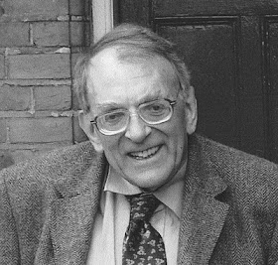
Where Israel of old stumbled and fell
Christ the new Israel stood firm
Michael Goulder

Slide 11
⁴ Hear, O Israel: The Lord our God, the Lord is one. ⁵ Love the Lord your God with all your heart and with all your soul and with all your strength.
Deuteronomy 6:4-5

